Slide 1
Gym Database
By : Mostafa Ayman Supervisor: Eng/Dalia Refaat
Shady Hisham Dr/Salah Elewa

Slide 2
Introduction
This database system was created to keep record of data of a gym. By taking information of gym members, employees, and trainers, it helps keep track of workout plans assigned to members by trainers. It also helps identify the trainer of each class and the schedule of all classes. Salaries and employment dates of employees and trainers are also stored in the system in addition to products and orders made my members.

Slide 3
Business Rules
1- The Gym has members, employees, trainers, and machines.
2- Each member has id, gender, ssn, full name, email, one or more phone numbers, address, age, weight, height, joining date. Each member must have one and only one membership. Each member may have a personal trainer or more, and a personal trainer may give a member more than one workout plan. Each member may participate in a class or more.
3-Each trainer must have a role, either a personal trainer or a class trainer. The personal trainer can train many members with different workout plans. The class trainer can be a trainer for one or more classes. Each trainer has id, full name, age, ssn, email, address, one or more phone numbers, gender, one or more qualifications, salary, and employment date . The trainer age must be between 20 and 55 years.
4-Each class has id, name, class time. The class does not exist if there is no class trainer for it. There can be more than one class in the same day and at same time. The class has one and only one trainer.
5-Each employee has id, full name, age, ssn, email, address, one or more phone numbers, gender, salary, and employment date. Each employee must have a role, either a bathroom worker, manager, sanitation worker or receptionist, The manager manages many employees. The employee has one and only one manager. The employee is treated as a member if he/she wants to have a membership in the gym. The employee age must be between 21 and 65 years
6-Each product has id, name, price, and description. Many products can be bought by members only. All products and their details are stored in the system
7-Role has id, name. The role can be bathroom worker, manager, sanitation worker, receptionist, personal trainer or a class trainer.
8-Each machine has id, name, description, and maintenance date.
9-Workout plan has id, name, description, duration. All plans are stored in the system to be given to members that have a personal trainer.

Slide 4
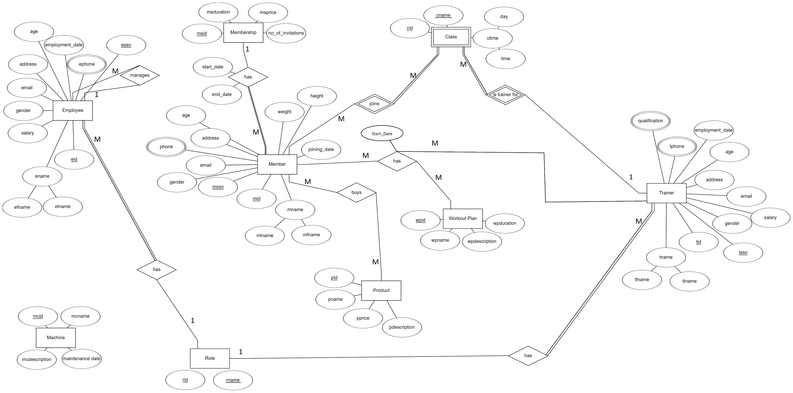
ERD

Slide 5
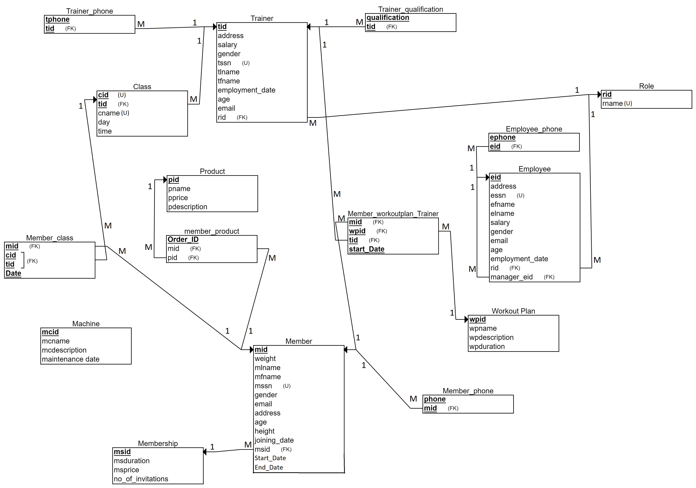
Relational Schema

Slide 6
NORmalization
All the tables are in the 3rd normal form

